Slide 1
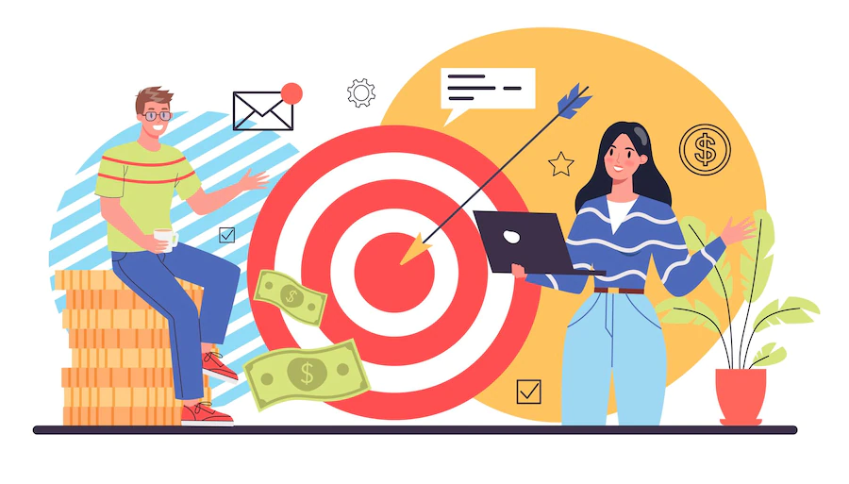
BUSINESS BOOSTERS
TEAM 7

Slide 2
OUR TEAM
Arshdeep Singh - B00890183
Bansari Hitesh Shah – B00910696
Bhavesh Lalwani – B00885318
Karan Singh Rathore -B00902792
Parul Raich – B00903203
Sagarkumar Vaghasia - B00878629

Slide 3
TABLE OF CONTENTS
BIG C- USERS
TECHNICAL COMPONENTS
Q&A

Slide 4
BIG C - USERS
With the application, we aim to provide a platform for start-ups and investors to engage with each other in a way not done before. When both, the start-up and the investor, swipe right, they match. The investor shows interest in the product after hearing about it from the start-up and wishes to invest. Investors fund the startups and they close off the deal by signing an agreement. It's a win-win on both sides.

Slide 5

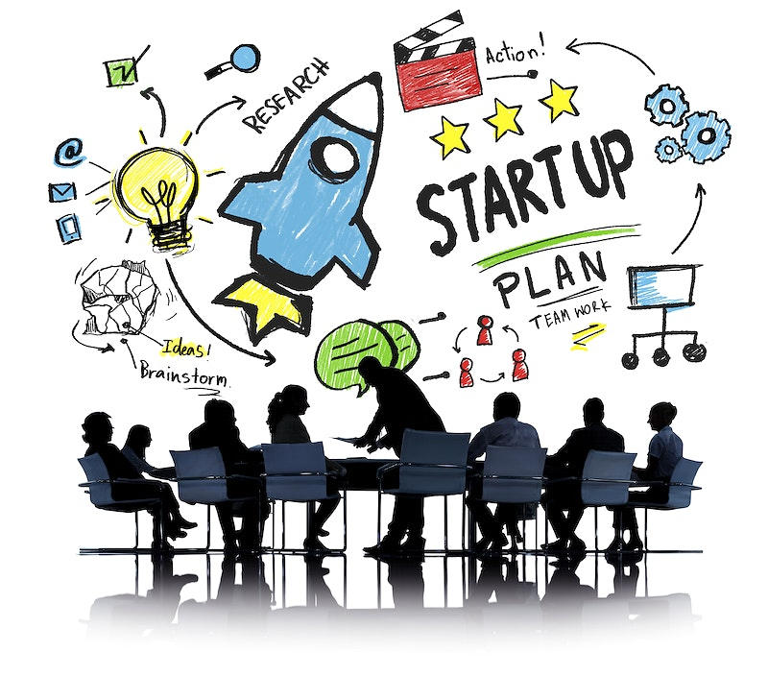
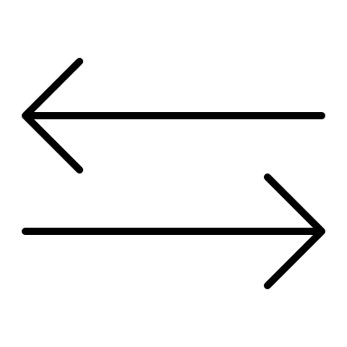
TARGET AUDIENCE – WHO ?
INVESTORS
Companies / people who are ready to invest in desired projects.
START UPS
Companies/people who are looking for fundings

Slide 6
TARGET AUDIENCE – WHERE ?
Our target audience are investors and start-ups where start-ups are looking for funding and investors are ready to invest money for profits.
Start-ups will be looking for investors who are ready to invest in their projects as in the initial level the start-ups are on low-budget.
Investors will be looking for dedicated companies that have the potential to scale and stay profitable.
Both start-ups and investors can search users based on their location and category of the start-up.
The start-ups do not need to wait for investment events, this app will facilitate them to attract funds whenever they wish to throughout the year.

Slide 7
APPLICATION FEATURES
Create profile as an investor or a start-up.
Search for their match according to their preferred location and category.
Left or right swipe the users based on their interest.
Provides visibility option to be in the search list of other users.
Left swiped users can be visible again by enabling an option.
Start-up can add funding details required by them.
Automatic chat will be created once both users match.

Slide 8
APPLICATION FEATURES (CONTD.)
Investor/start-up can schedule as many meetings as they need to.
Once the meeting has been scheduled, other person can either accept/reject the meeting.
All the scheduled meetings will be listed on the user screen so it is easy for them to manage in one place.
Both the parties can record the deals with each other by confirming/rejecting the initiated deal.
Can search the matched users

Slide 9
SIGNIFICANT ATTRIBUTES
Usability
Search investor/start-up based on their preference: location and category
Minimalistic Design
Security
We provided firebase authentication as part of securing the user credentials.
Accessibility
Implemented search functionality
Can swipe users either left/right
Legal Compliance
Adopting Terms and Conditions
EULA Statement

Slide 10
WHY THIS APPLICATION ?
No such platform exists.
Investors gets to view startups looking for funding.
Startups gets to reach out to active investors looking to invest.
Meeting like-minded investors/startups.
Allows the hunt to be on for 24*7.
Need not wait for any showcase events.
Even the startups who don't qualify for certain events can showcase their business.
Ability to record their deals and meetings.

Slide 11
DELIVERY
Google Play Store

Slide 12
BUSINESS MODEL
Freemium
Subscription (Silver, Gold, Diamond)

Slide 13
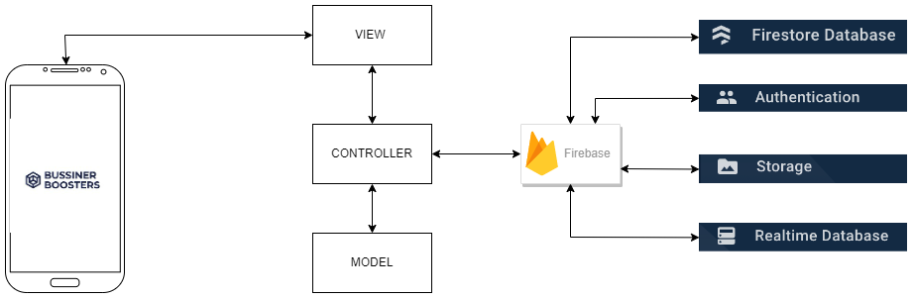
ARCHITECTURE
Fig.1: architecture [1]

Slide 14
PROBLEMS
Learning Gap due to lack of prior experience with Kotlin and android frameworks lead to initial delays in understanding the structure.
Difficulty in understanding fragment or activity-based division of modules and features.
Incompatibility with some device-specific features of an emulator, caused confusion on the workability of the application features.
The layout XML file's UI previews and the actual phone had differing user interfaces.

Slide 15
PROBLEMS (CONTD)
We intended to include the LinkedIn API in our project to allow users to sign-in with the LinkedIn credentials in our application but the Mobile SDK for the API has been officially removed from the website and the available unofficial version of the APIs on GitHub are not maintained well and give inconsistent responses, which is why we had to drop that feature. The current version is also not compatible with retrofit and has issues while parsing JSON [2].
Incompatibility issues between gradle versions and current dependencies.

Slide 16
PROJECT EFFORTS
We researched different ideas for the application before the proposal.
We divided the work equally among us by meeting in person after the lectures once per week.
We learned Kotlin and android development from lab assignments, YouTube, and Udemy.
We developed features and integrated them by meeting in Goldberg to solve integration issues and bugs efficiently.

Slide 17
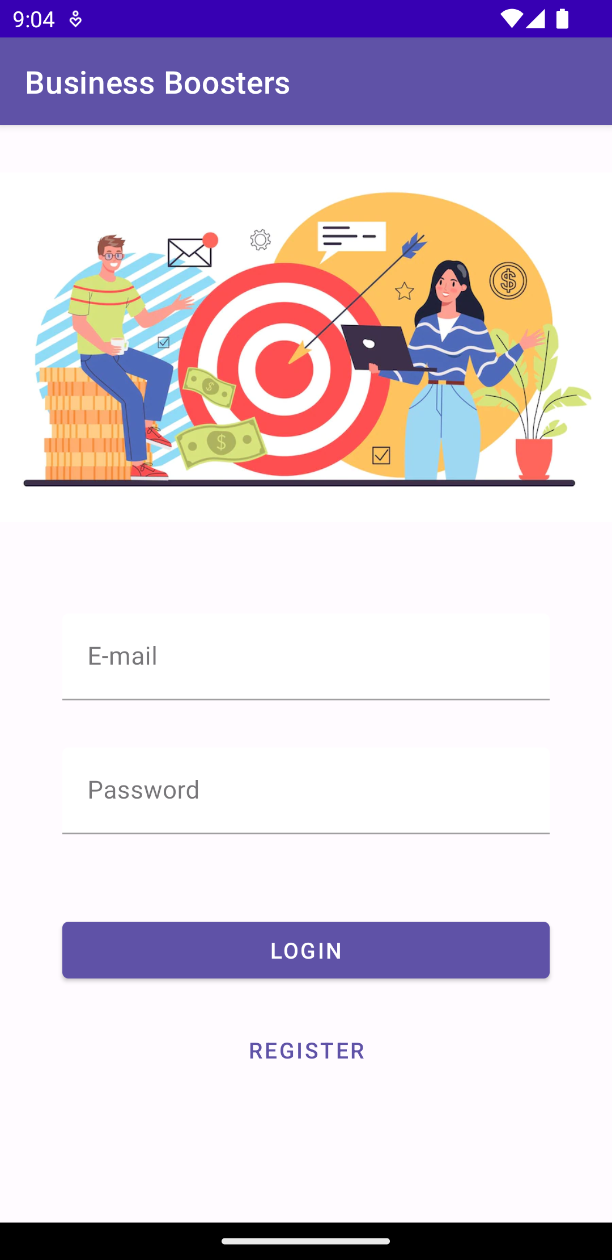
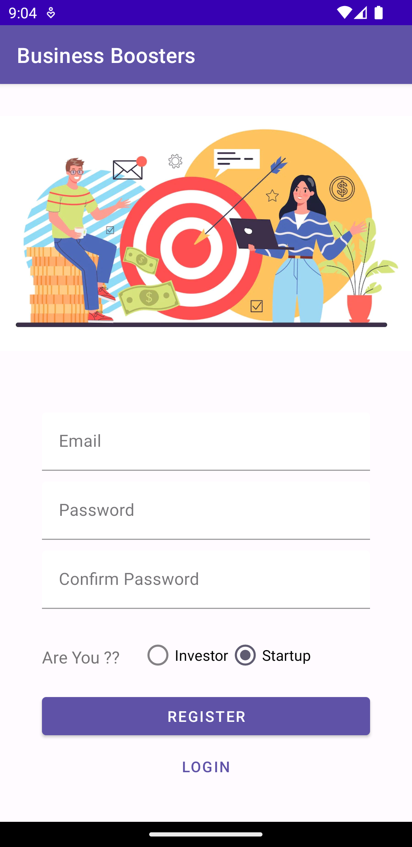
App Screens – Log In & Register
Login
Register

Slide 18
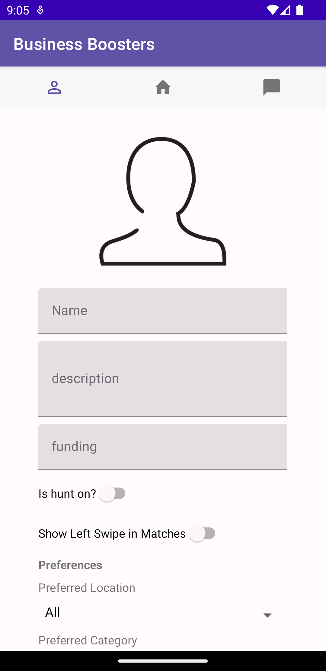
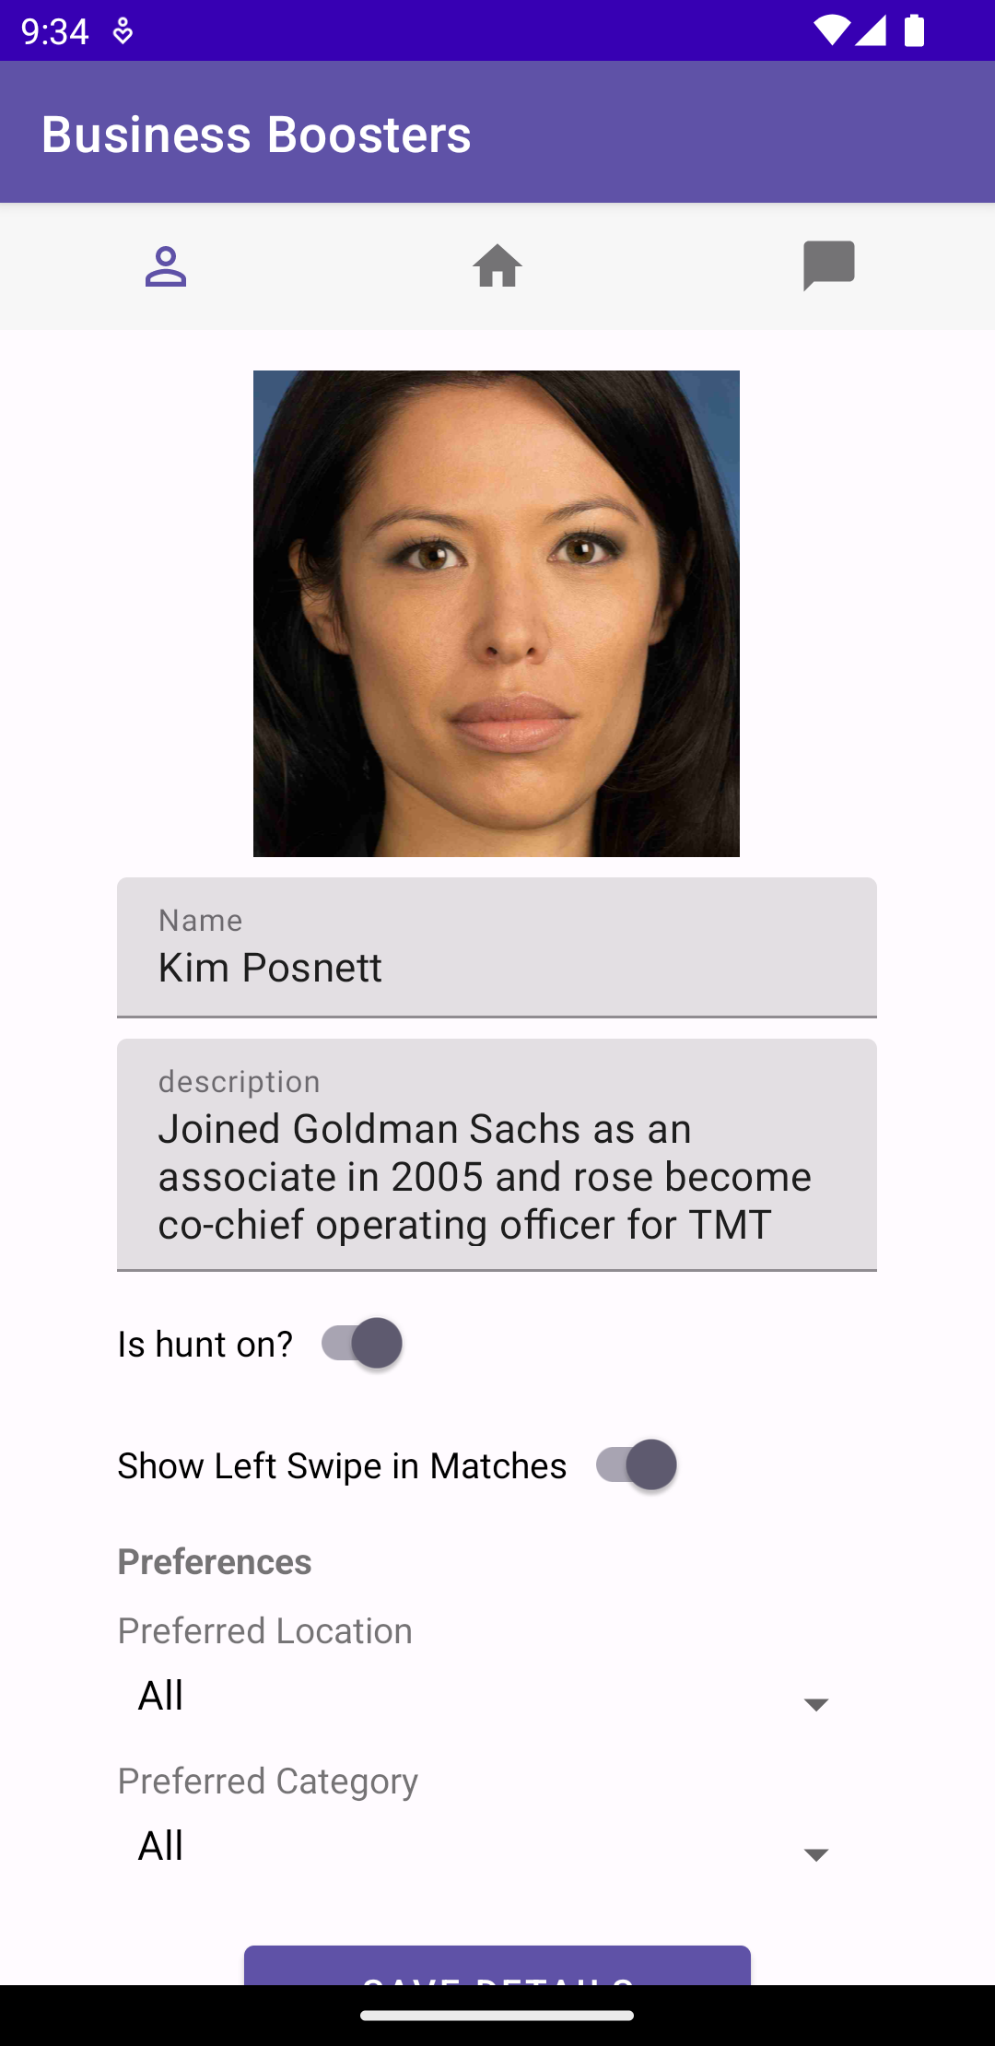
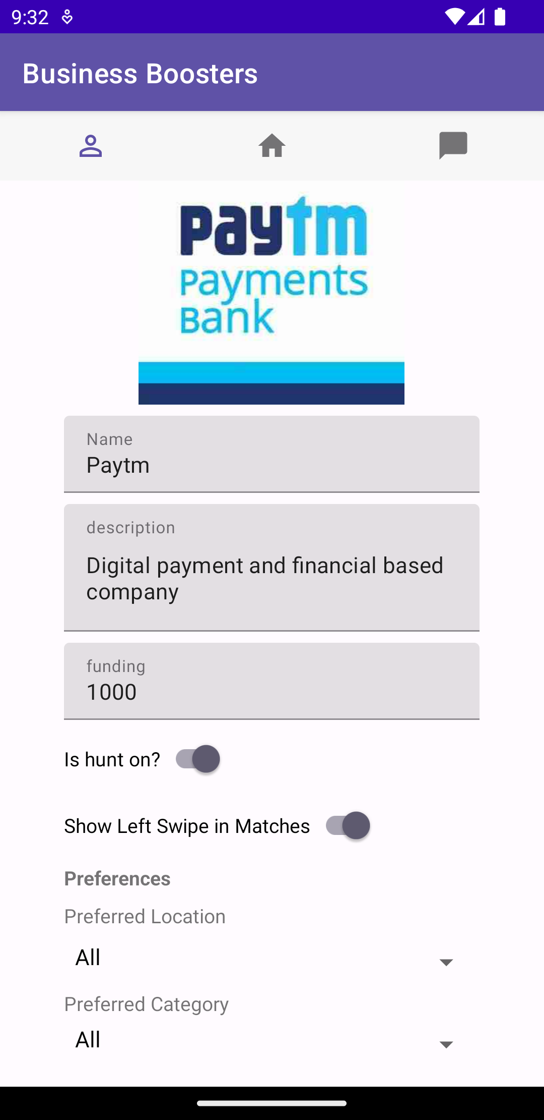
App Screens – Profile Details
Profile Set-Up
Investor's Profile
Start-up's Profile

Slide 19
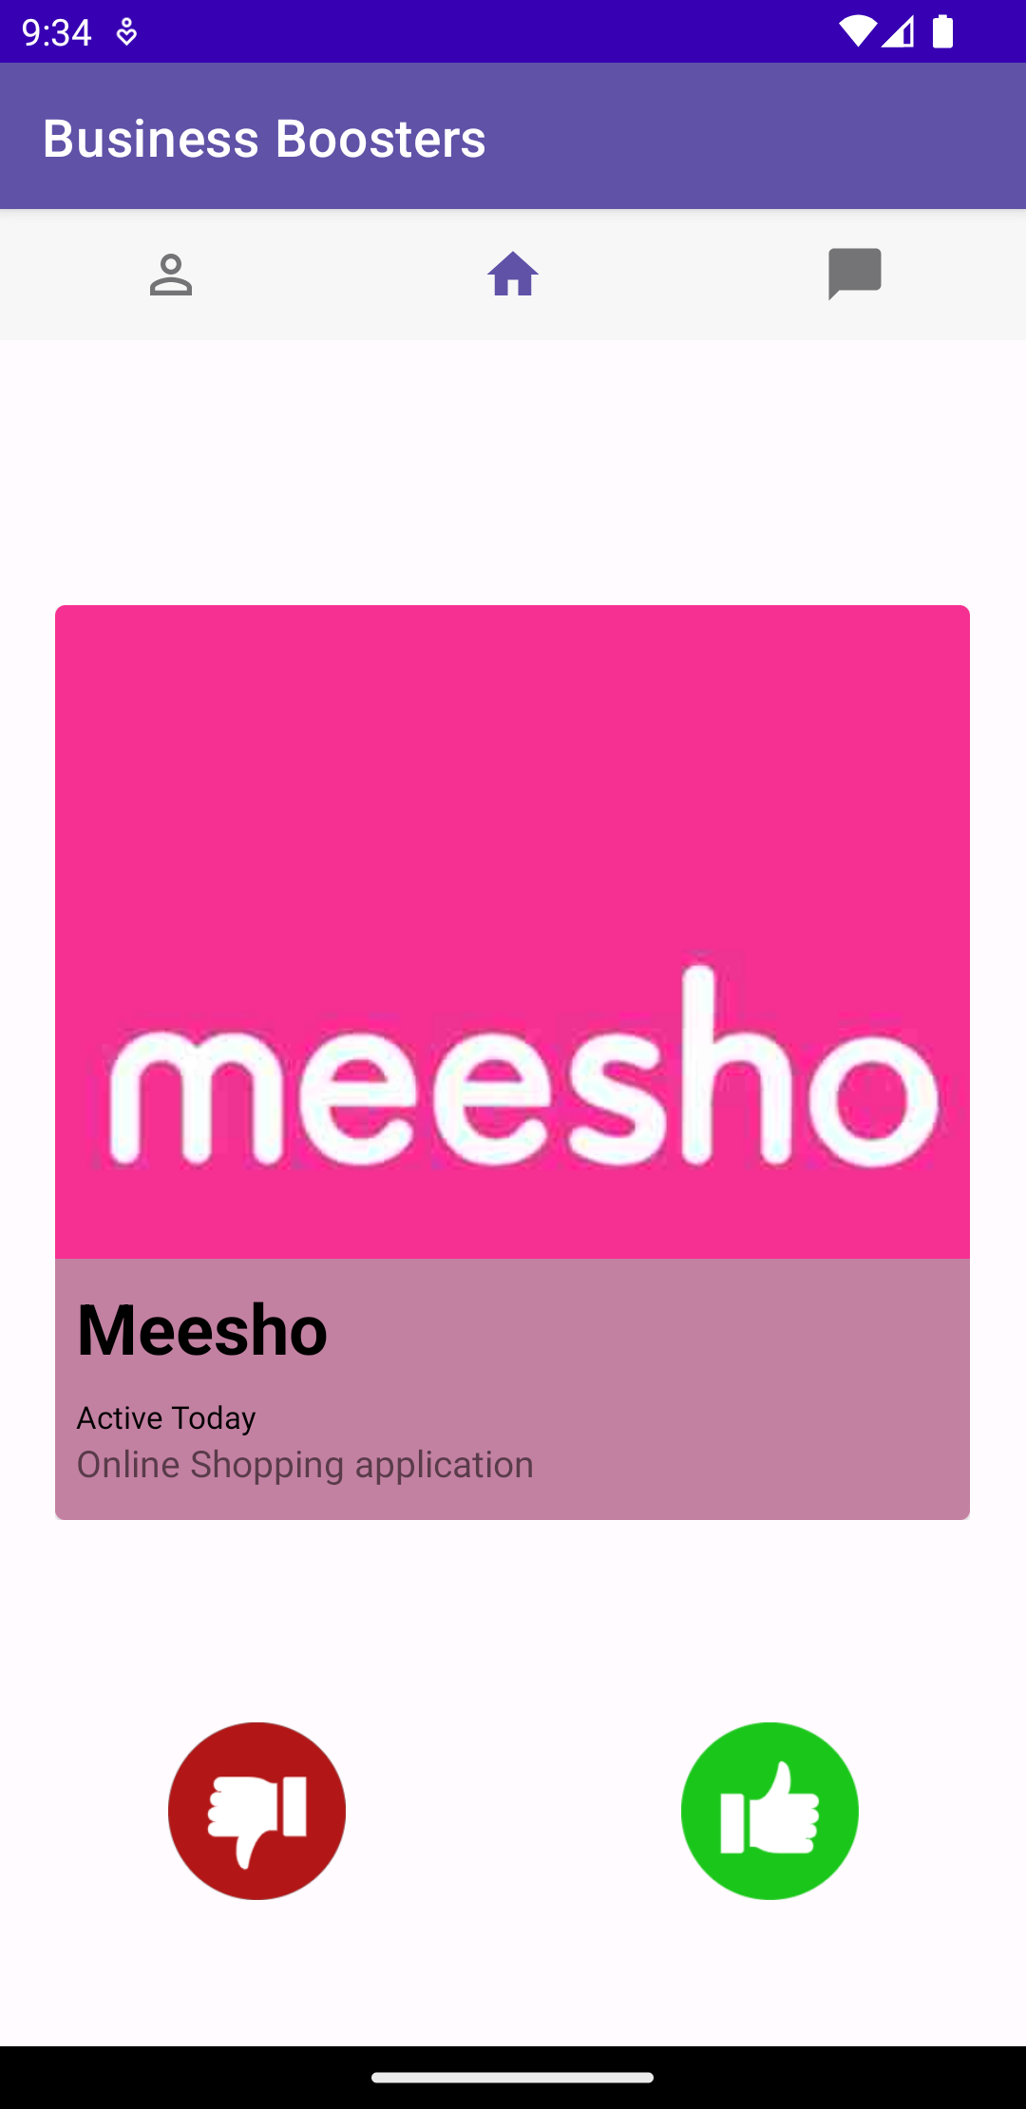
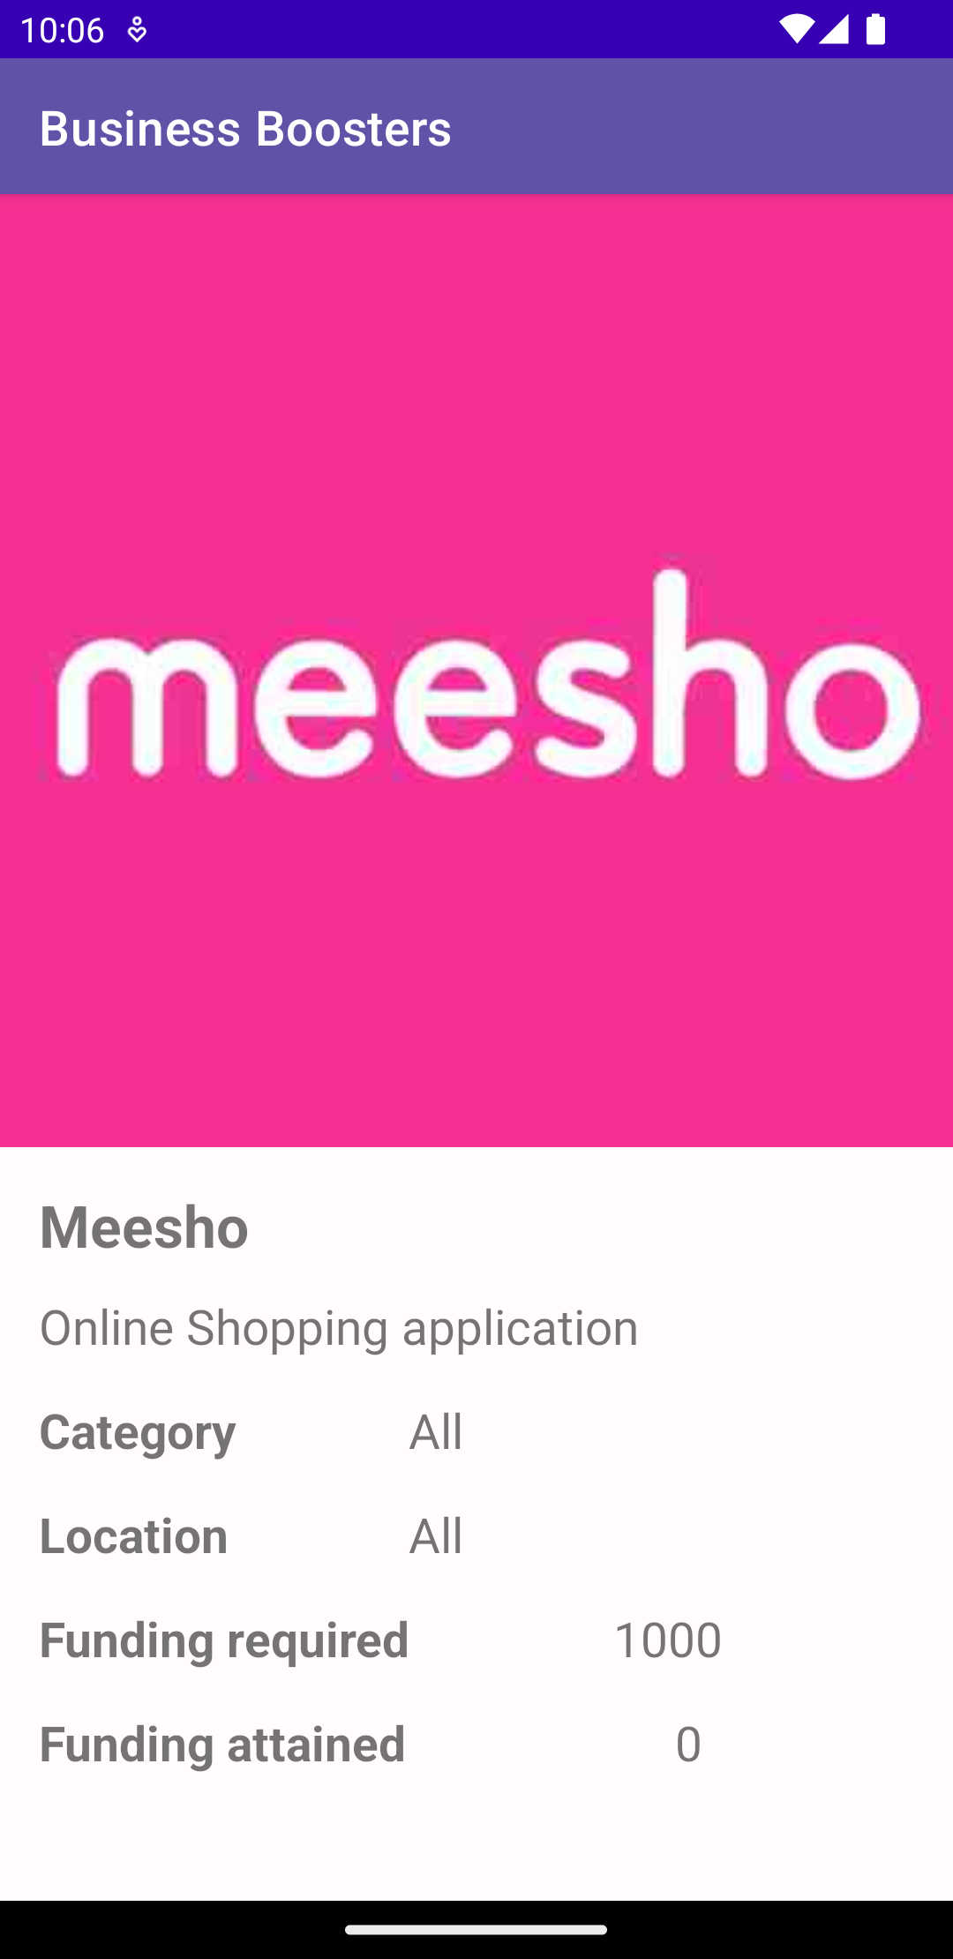
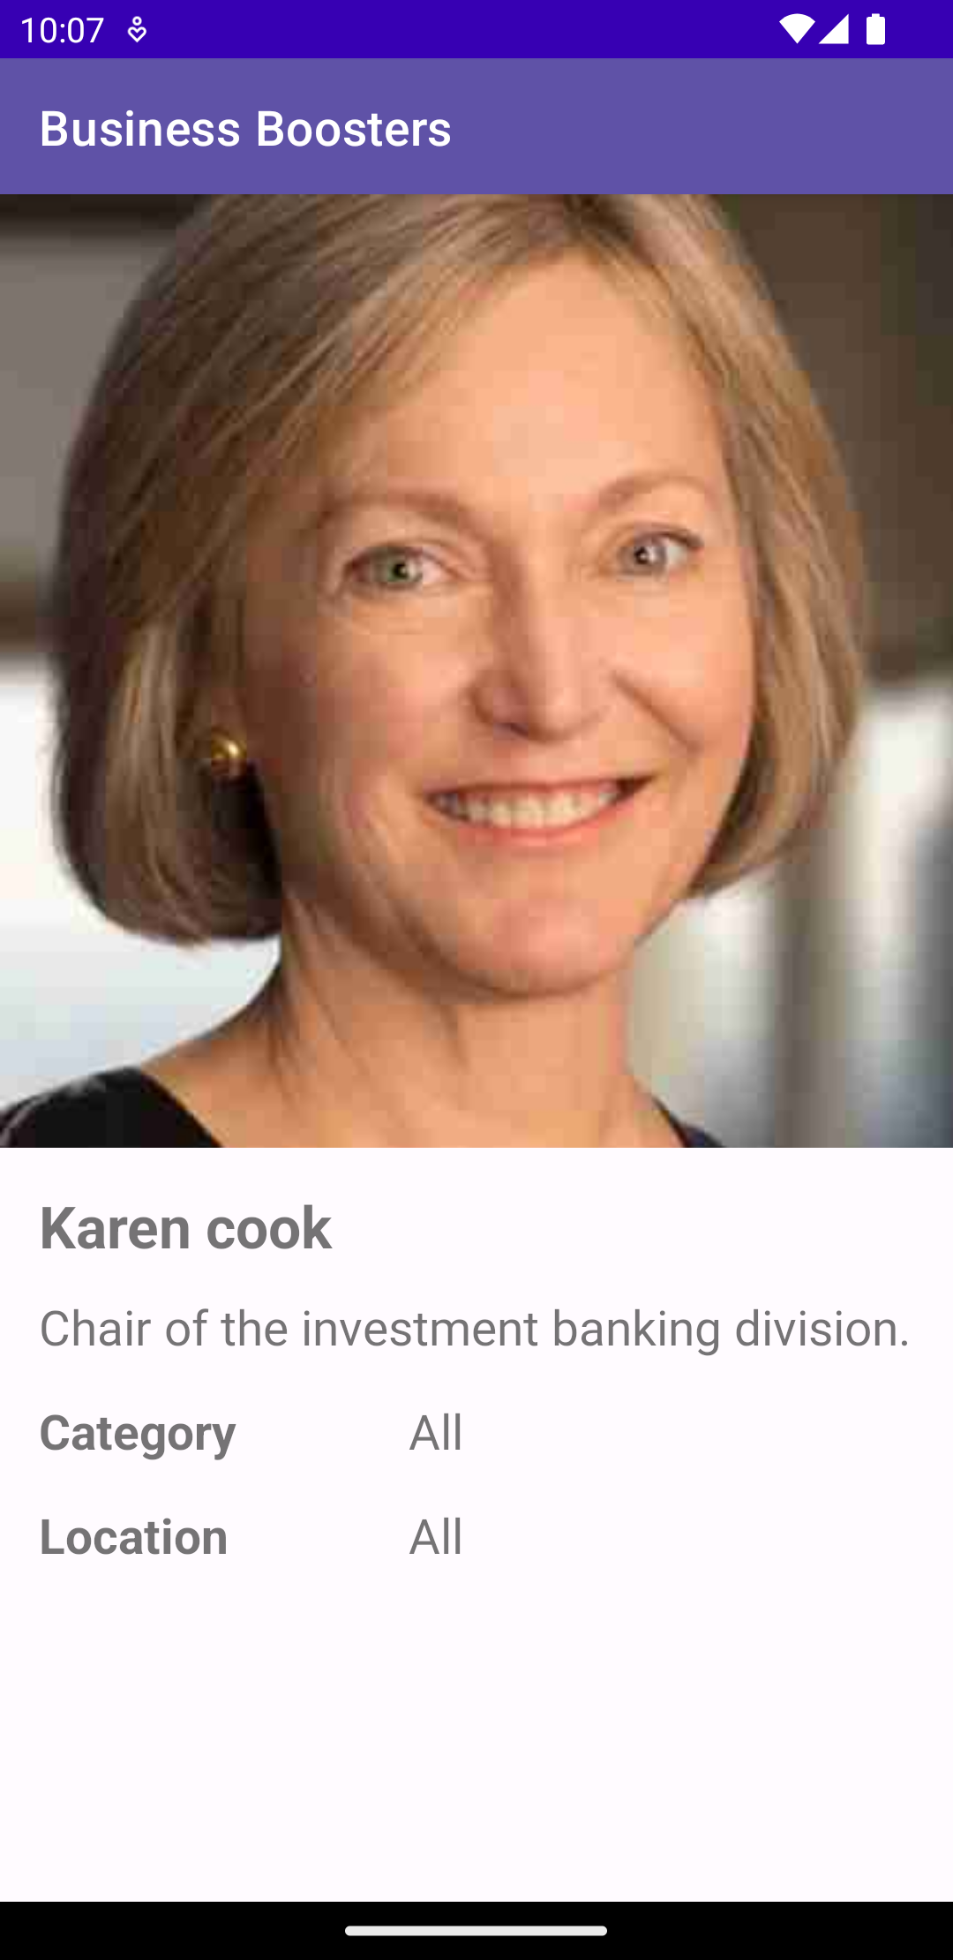
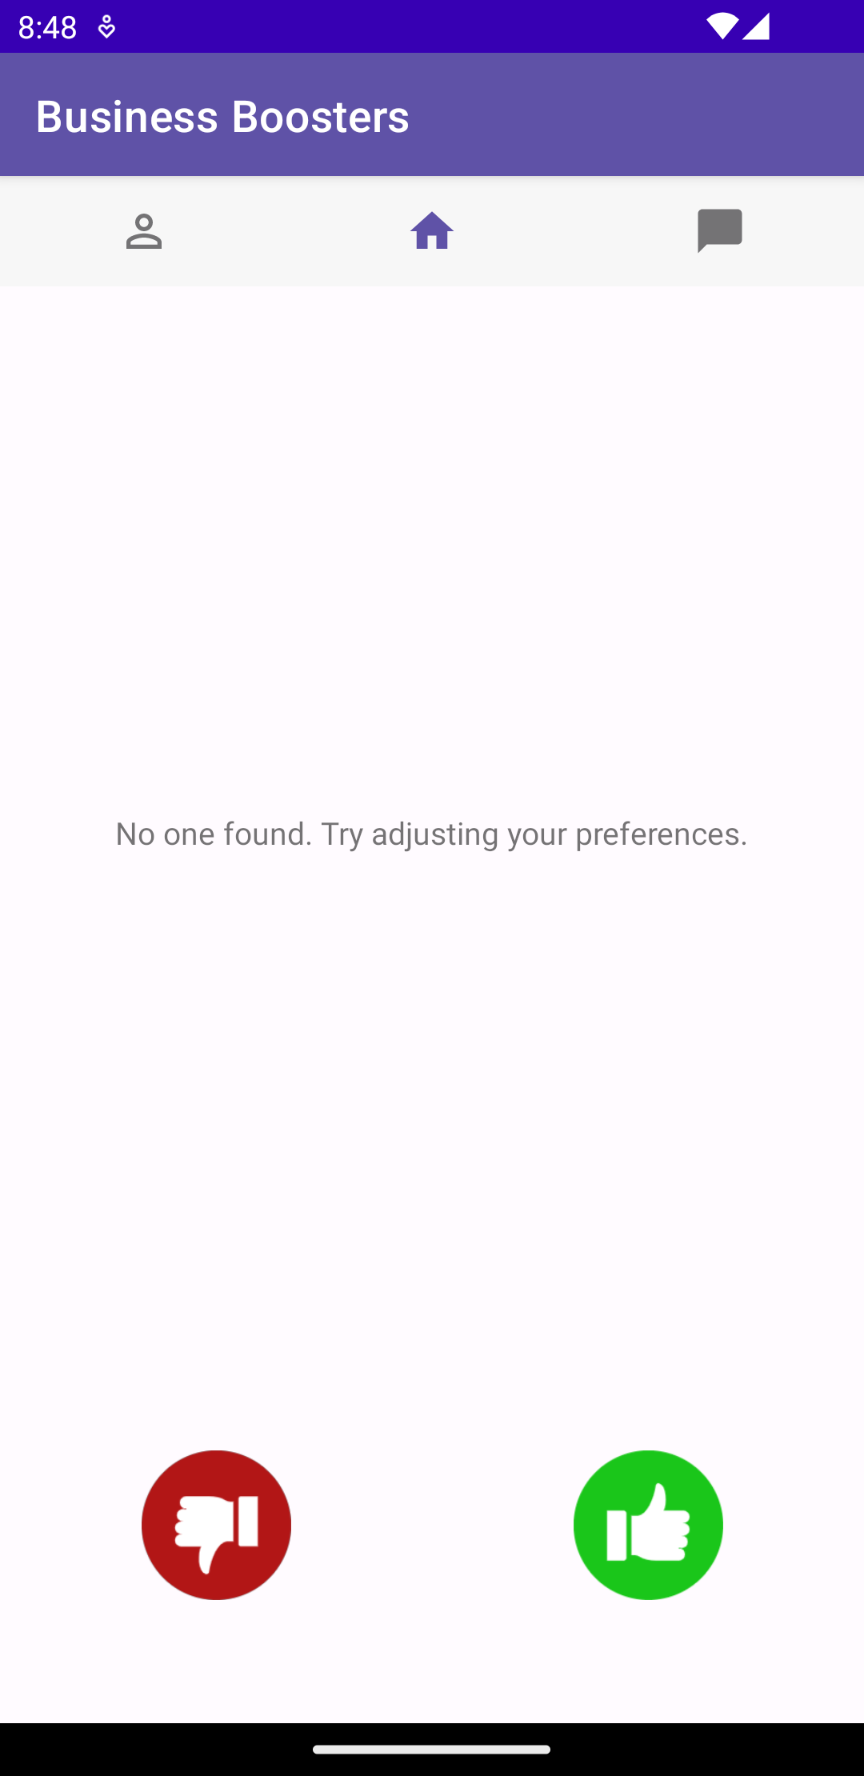
App Screens – Swipe
SwipeDeck
Start-up Details
Profile Details
No More Users

Slide 20
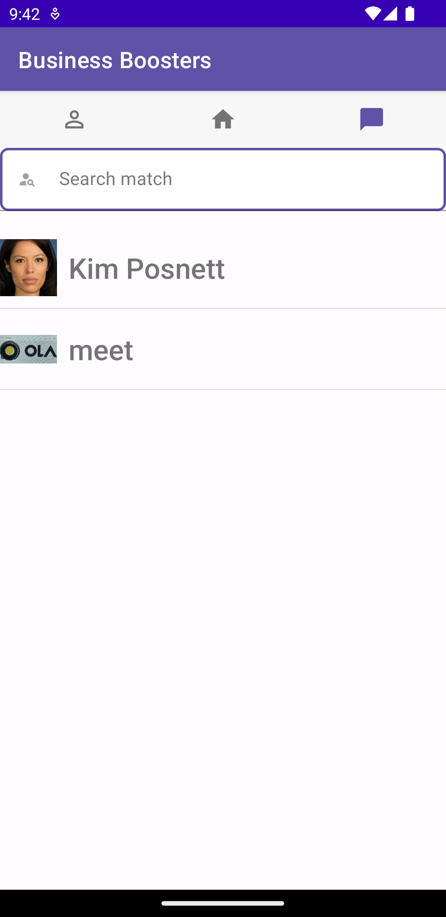
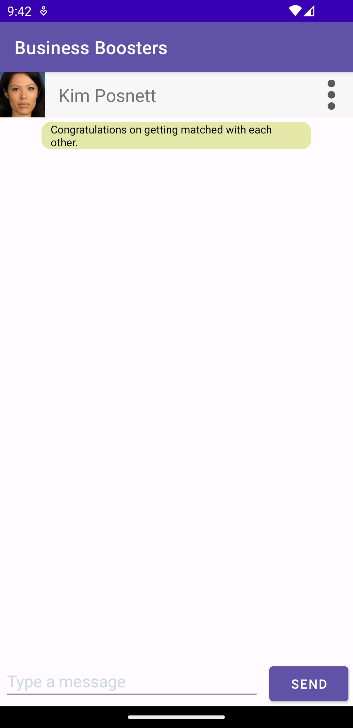
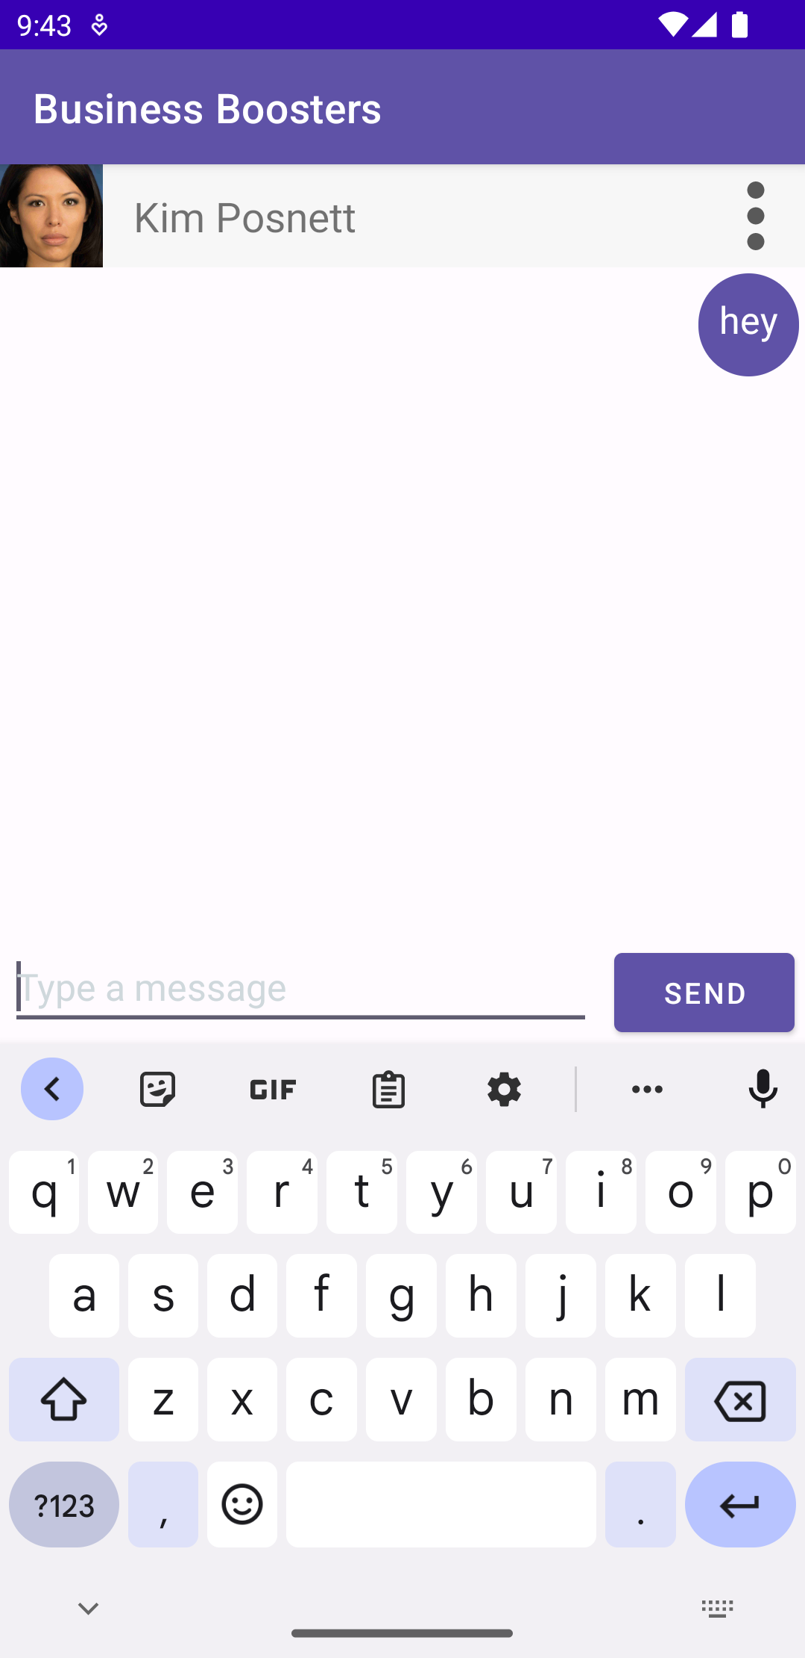
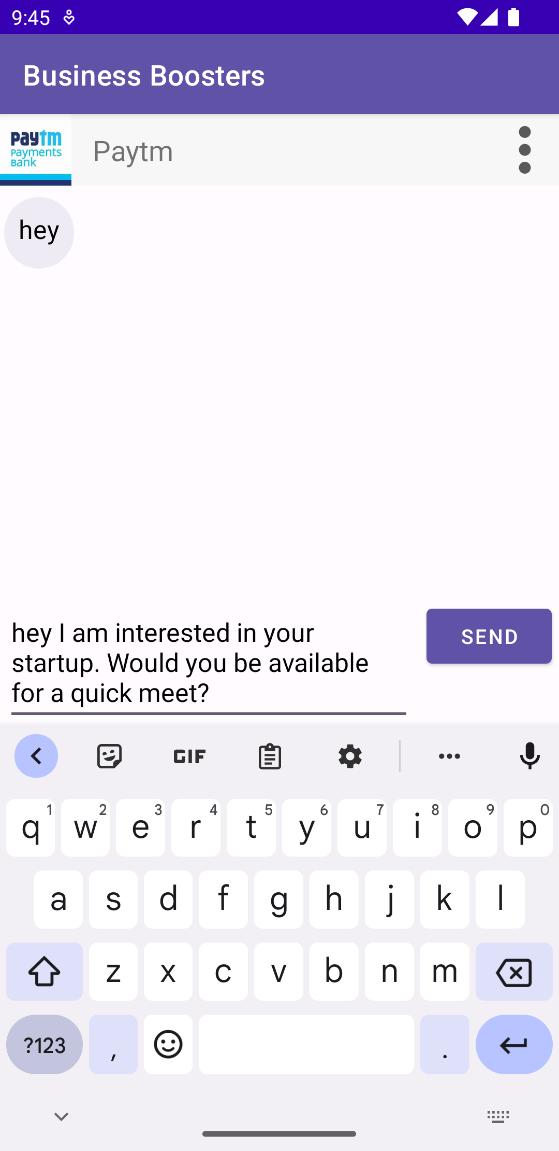
App Screens – Conversations
Conversations
Conversation Screen
Messaging an Investor
Messaging a Start-up

Slide 21
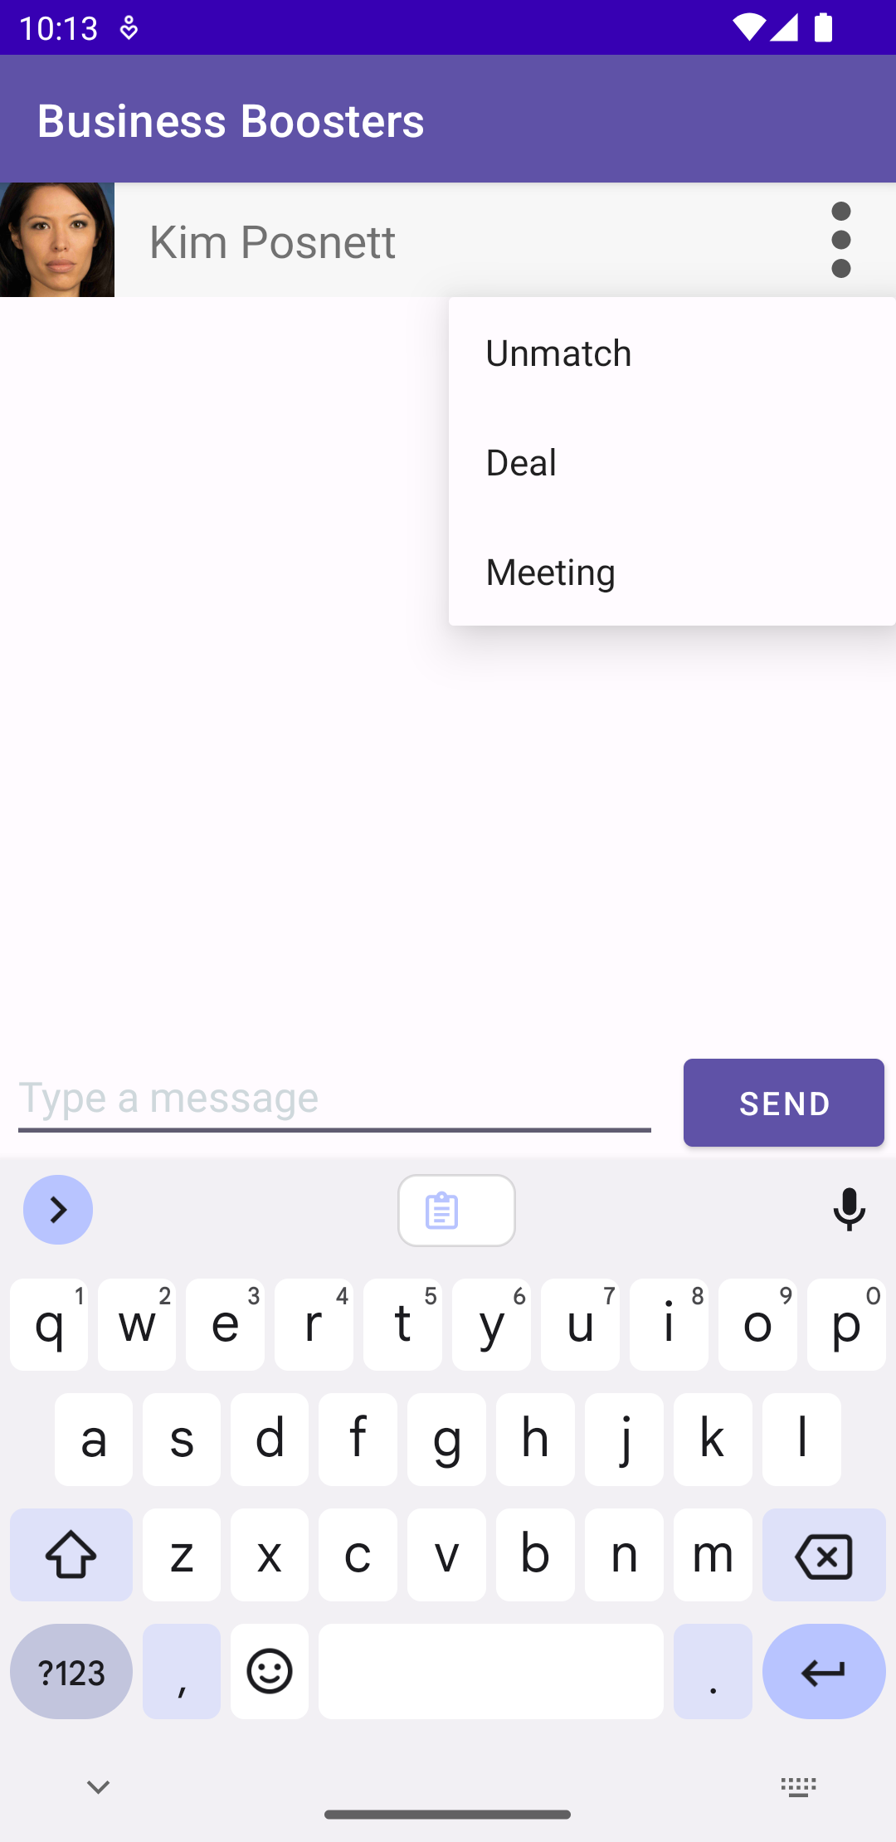
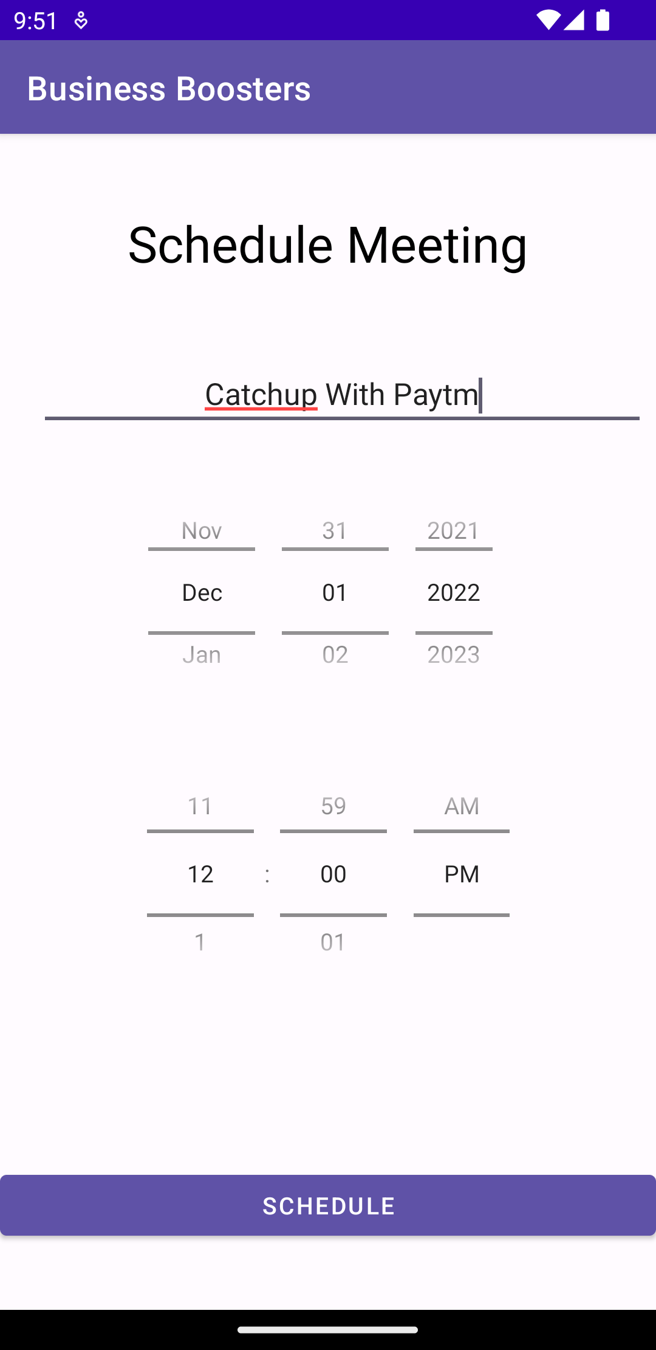
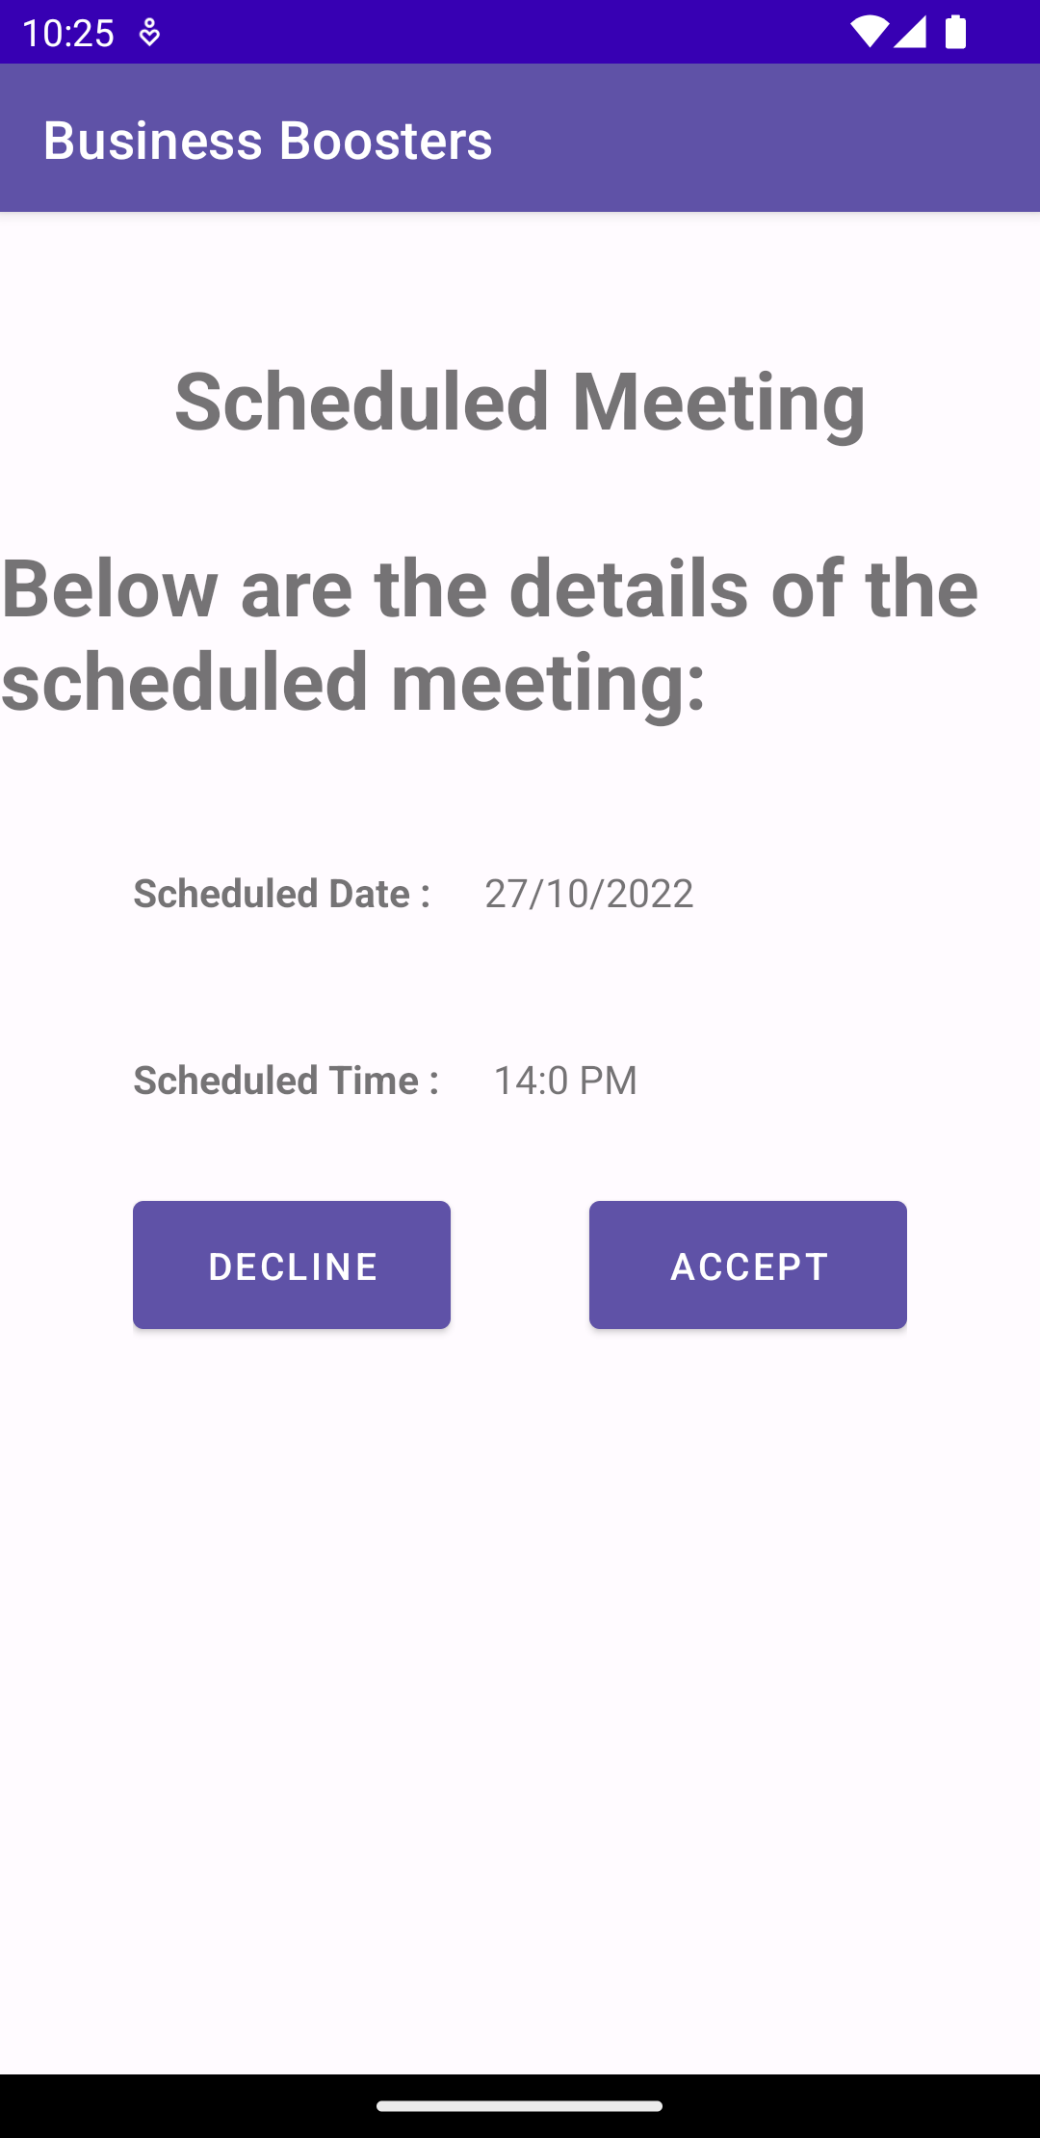
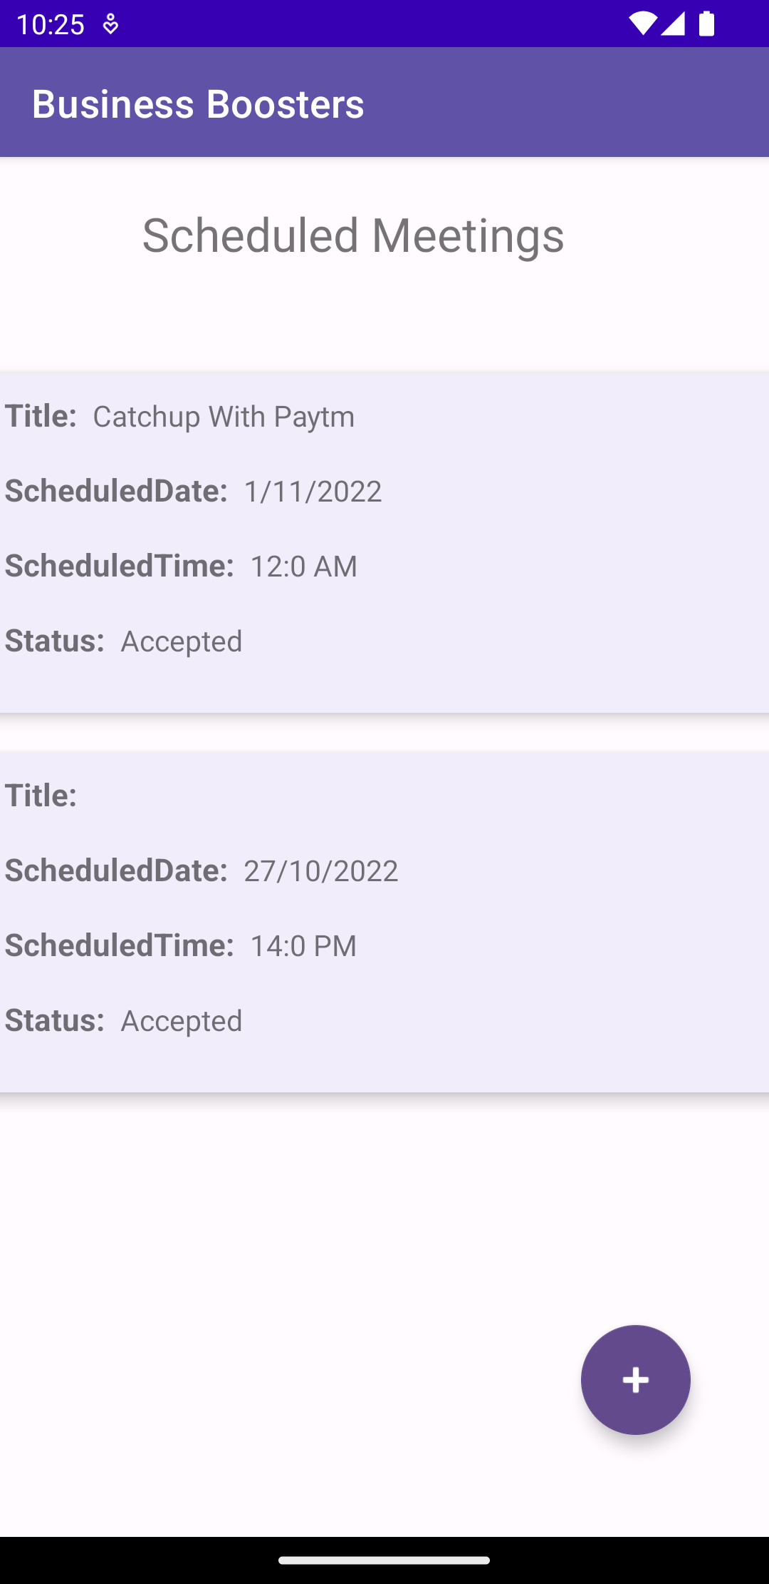
App Screens – Meeting Schedule
Schedule Meeting
Meeting Date & Time
Meeting Proposed
Accepted Meetings

Slide 22
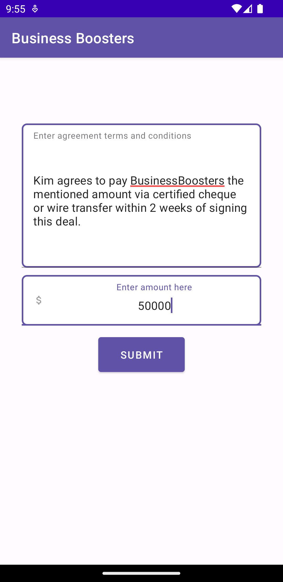
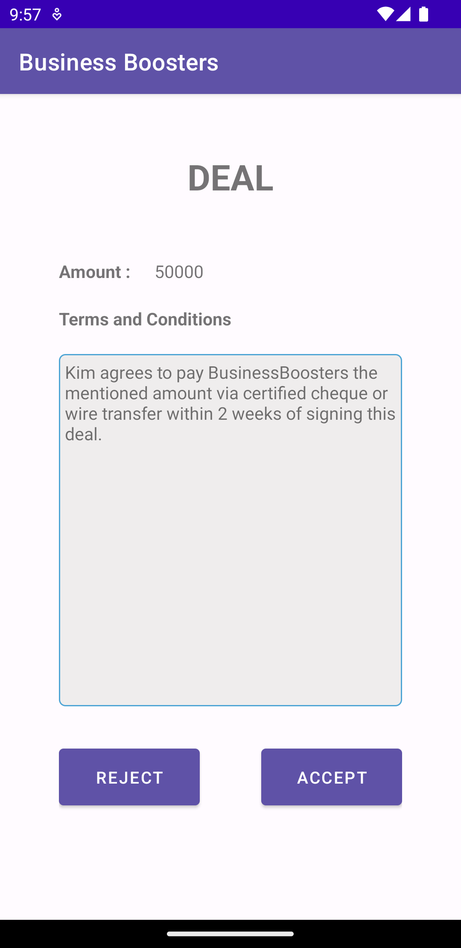
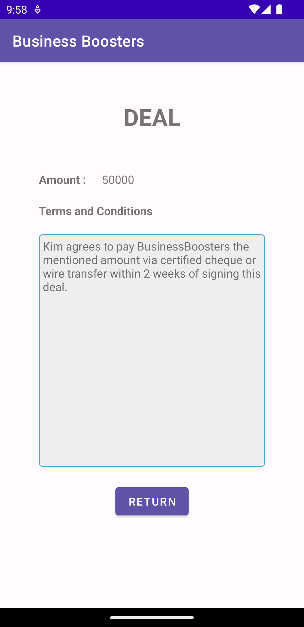
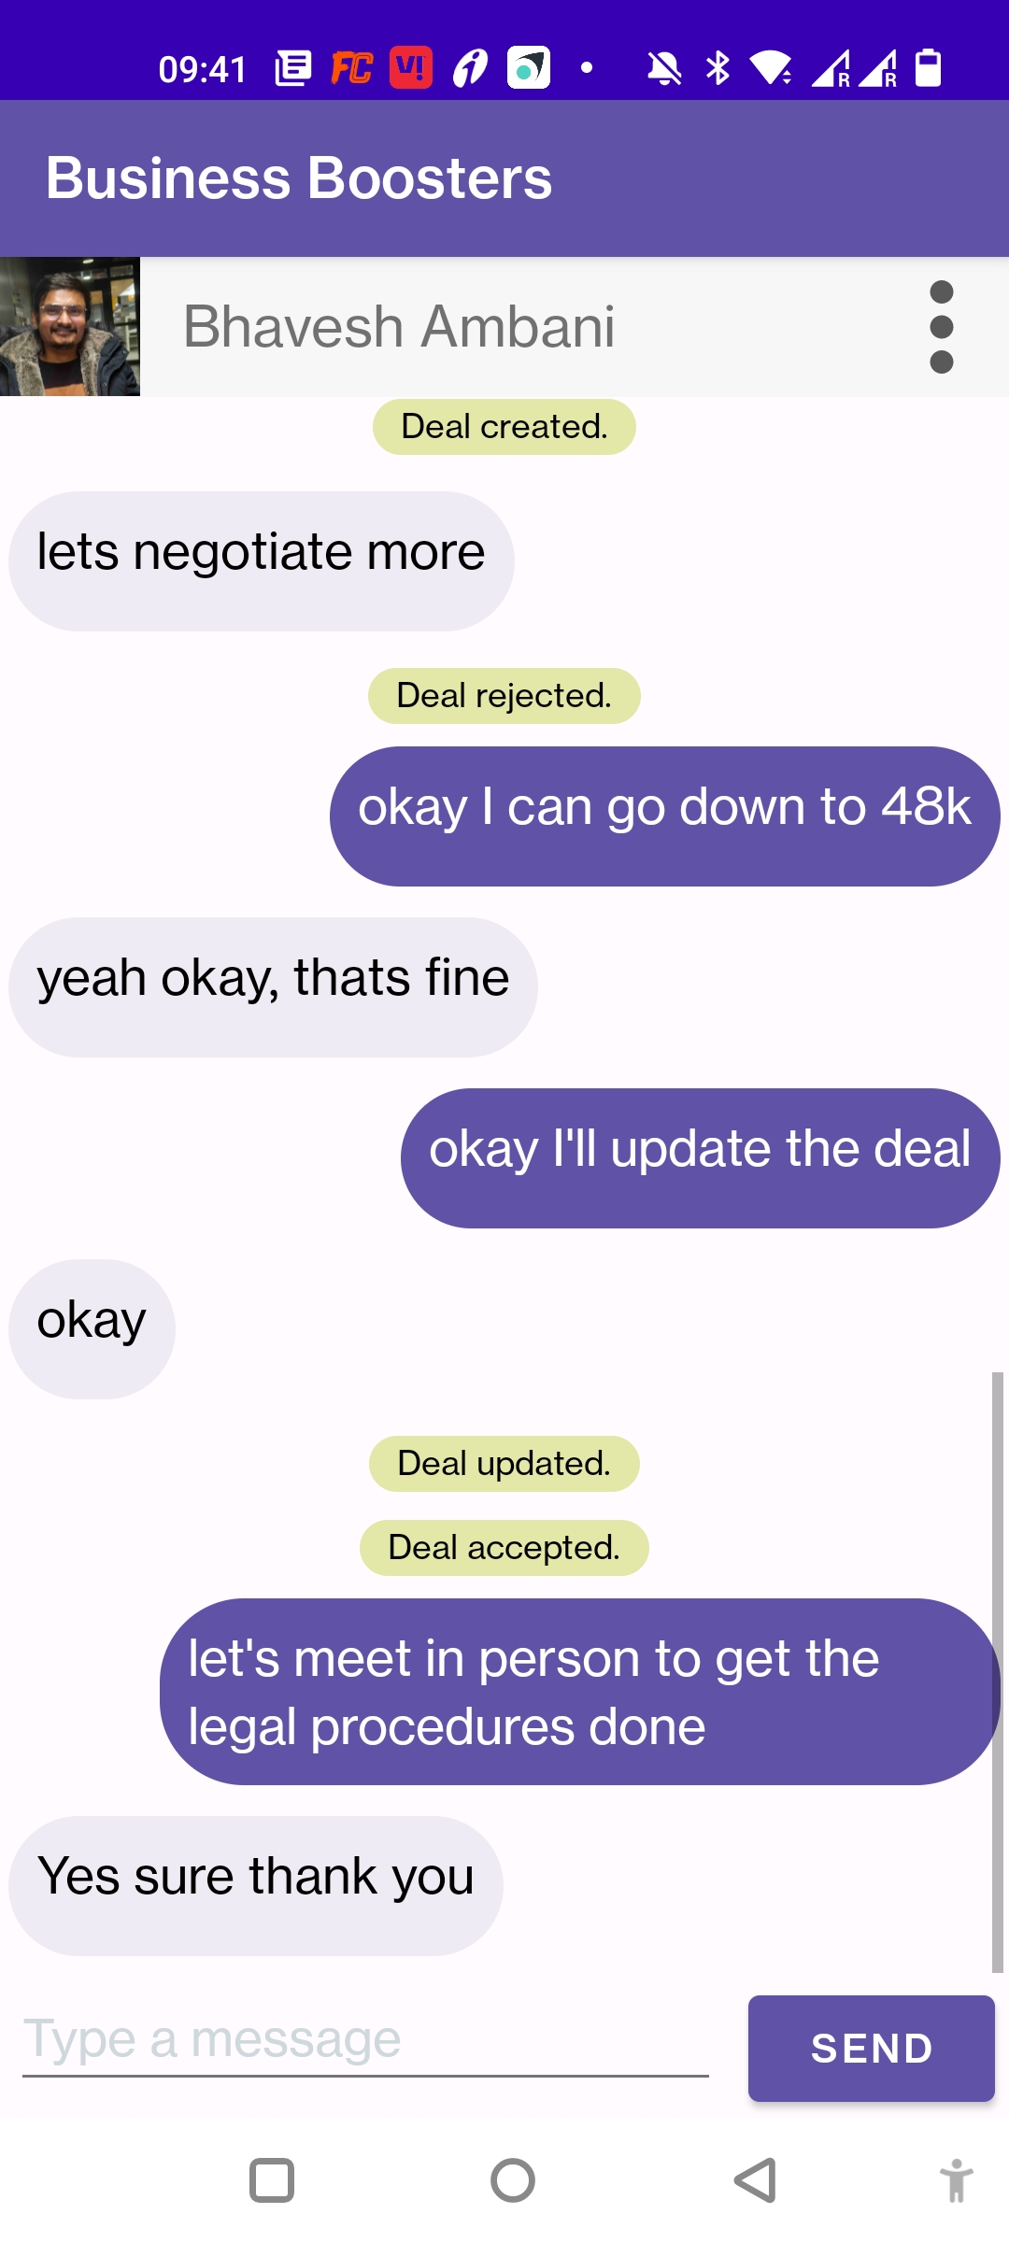
App Screens – Finalize Deal Agreement
Initiate Deal
Deal Agreement Details
Deal Agreement Proposed
Deal Agreement Accepted
Deal Status In Chat

Slide 23
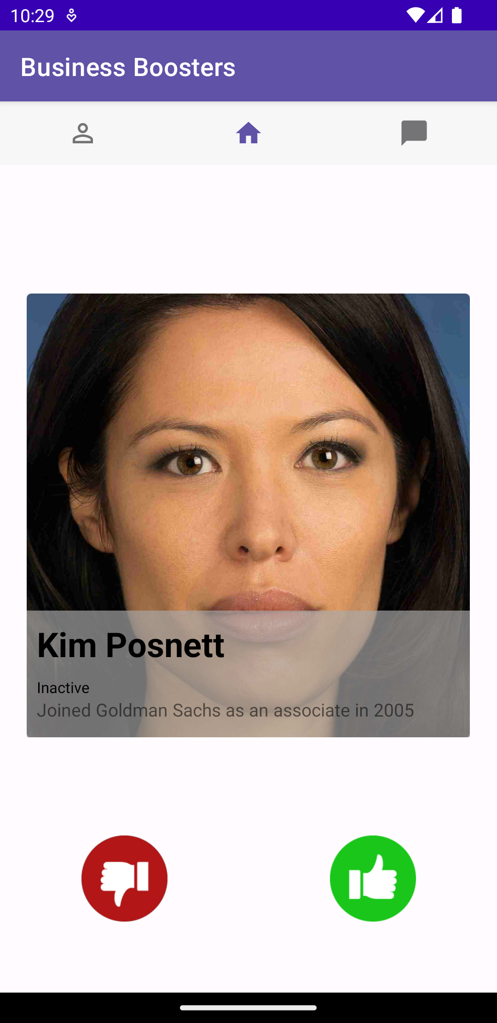
App Screens – Un-match
Initiate Un-match
Re-swipe on un-matched investors

Slide 24
QA TESTING APPROACH
To maintain the consistency and avoid the feature breakdown we have used logger provided by Kotlin which will display the errors in terminal of the IDE when android application is running on device and face any exception or errors.
All the features are manually tested .
Our application is also tested by other users who are not part of our team such as friends, colleagues, etc. This is done to get feedback from users for improvements in the application.
Errors from the developer's point of view such as application errors or database errors are translated into simple language for the user to comprehend.
We have also tested the prototypes (storyboards, site-maps, wireframes, etc.) to verify the flow of the modules and application.

Slide 25
QA TESTING APPROACH
We were also monitoring the firebase and fire-store database while testing to get insights about real-time data.
We have also validated the input fields in each modules and fragments by setting validations.
Application is packaged with the dedicated modules for models, fragments and activities which will help the future developers to understand the code.

Slide 26
REFERENCES
[1] Flowchart Maker & Online Diagram Software. Flowchart Maker & Online Diagram Software. Retrieved November 30, 2022 from https://app.diagrams.net/ .
[2] shantanu-deshmukh. 2019. GitHub - shantanu-deshmukh/LinkedIn-SDK-Android: LinkedIn SDK for Android (UnOfficial) : Easily implement Login with LinkedIn in your android app. GitHub. Retrieved November 30, 2022 from https://github.com/shantanu-deshmukh/LinkedIn-SDK-Android

